Slide 1
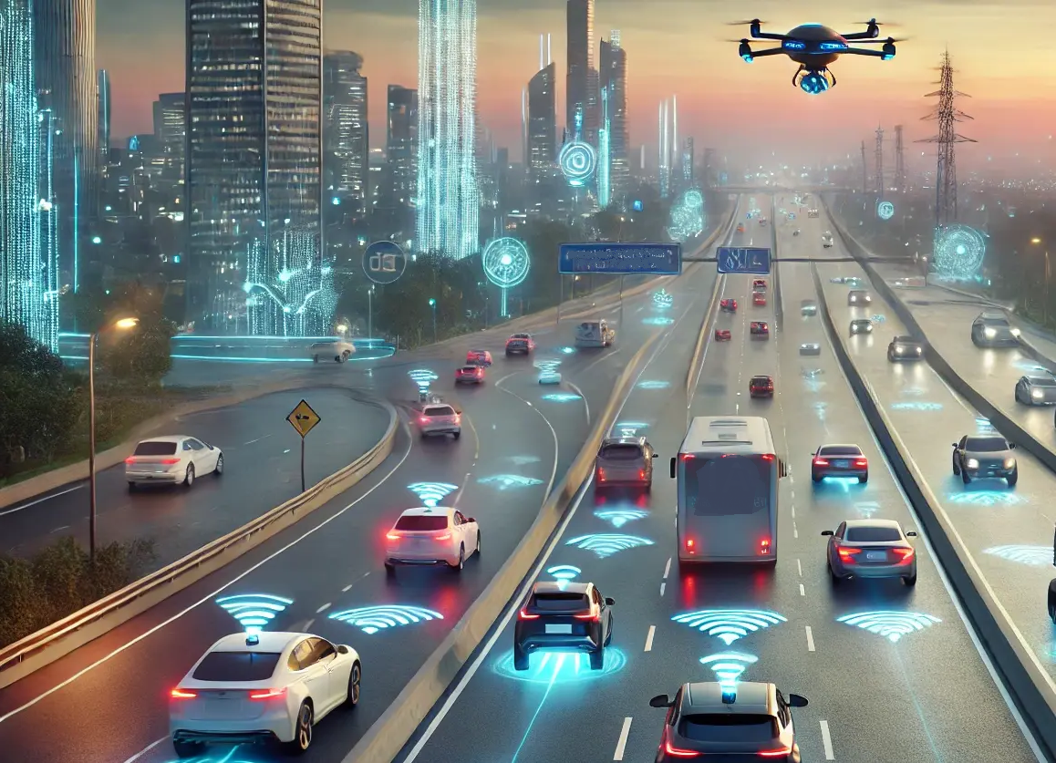

Capstone Project AI-Powered Road Accident Detection and Automated Rescue Alert System
GUIDED BY:
Prof. DR.Vijayaragavan
DR.S.K.Aruna
Presented by:
K.Tejaswi(192525407)
M.Nagashalini(192524183

Slide 2

Introduction
Road accidents are a major cause of injuries and fatalities worldwide, affecting public safety and transportation systems.
Delayed accident reporting often prevents victims from receiving immediate medical assistance, increasing the risk of severe consequences.
Quick emergency response is essential to improve survival rates and reduce the impact of injuries.
Traditional reporting methods rely on victims or witnesses, which may not be possible during serious accidents.
The proposed system uses Artificial Intelligence (AI) and Python-based technologies to automatically detect accident events in real time.
Once an accident is detected, the system instantly sends alerts with location details to emergency services, enabling faster rescue operations and improving road safety.

Slide 3

Objectives
Detect road accidents automatically using AI-based techniques.
Generate instant emergency alerts upon accident detection.
Share accurate accident location details with rescue services.
Store and manage accident records for future analysis.
Analyze accident data to identify trends and improve decision-making.
Enhance road safety by reducing rescue response time and improving emergency assistance.

Slide 4

Problem Statement
Emergency services often lack a mechanism to identify accidents immediately after they occur.
Critical information such as accident location and severity is not available in real time to rescue teams.
Manual monitoring of road incidents is inefficient and cannot cover all locations continuously.
Lack of automated communication between accident sites and emergency responders leads to operational delays.
Absence of centralized accident data collection makes it difficult to analyze patterns and improve road safety measures.
Therefore, there is a need for an intelligent system that can automatically detect accidents, assess the situation, and initiate rescue alerts without requiring human intervention.

Slide 5

Traditional Accident Reporting Systems
Accident information is often reported manually, leading to delays in emergency response.
Rescue teams may not receive accurate details about the accident location and severity.
Communication between accident sites and emergency services can be slow and inefficient.
Traditional systems lack continuous monitoring and instant accident detection capabilities.
Accident data is not effectively stored or analyzed for identifying safety trends and risk zones.
The absence of automation reduces the overall efficiency of rescue operations and road safety management.

Slide 6

Smart Accident Detection & Rescue Alert System
Uses Artificial Intelligence (AI) and sensor data to automatically identify road accidents without human intervention.
Continuously monitors vehicle conditions and surroundings through a real-time monitoring system.
Instantly generates emergency rescue alerts when an accident is detected, reducing response delays.
Automatically shares the exact accident location with emergency services and registered contacts using GPS.
Maintains a centralized database to store accident records for future analysis and decision-making.
Analyzes collected data to improve emergency response strategies, enhance road safety, and reduce accident-related casualties.

Slide 7
Module 1 – AI-Based Accident Detection
Continuously monitors traffic using cameras and sensors placed on roads.
Detects accidents automatically by analyzing vehicle movements and collision patterns.
Identifies unusual events such as sudden stops, rollovers, or vehicle crashes.
Determines the severity of the accident based on the impact and damage indicators.
Records important information such as accident time and location.
Sends the detected accident details to the rescue alert system for immediate action.

Slide 8
Implementation
Roadside cameras and IoT sensors are used to collect real-time traffic data.
Video frames are preprocessed using OpenCV to improve image quality and remove noise.
AI models such as YOLO or CNN are employed to detect and track vehicles.
Machine learning algorithms analyze vehicle speed, direction, and collision behavior.
When an accident is detected, the system classifies its severity and verifies the event.
The accident information is stored in a database and forwarded to the emergency response module.

Slide 9
Module 2 – Automated Rescue Alert and Emergency Response
Receives accident information immediately after it is detected by the AI system.
Retrieves the exact accident location using GPS for accurate emergency assistance.
Automatically generates and sends alerts to nearby ambulance services, hospitals, and police stations.
Notifies the victim's registered emergency contacts through SMS or mobile notifications.
Provides real-time updates on rescue team dispatch and response status.
Ensures faster emergency response, reducing delays and improving victim safety.

Slide 10
Implementation
Integrate GPS and GSM modules to obtain location data and enable communication.
Develop an alert generation system that activates when an accident is confirmed.
Use cloud servers or databases to store accident details and emergency contact information.
Connect with ambulance, hospital, and police service APIs for automated notifications.
Send SMS messages or mobile app alerts containing accident location and severity details.
Track rescue operations through a dashboard and provide real-time status updates until assistance arrives.

Slide 11
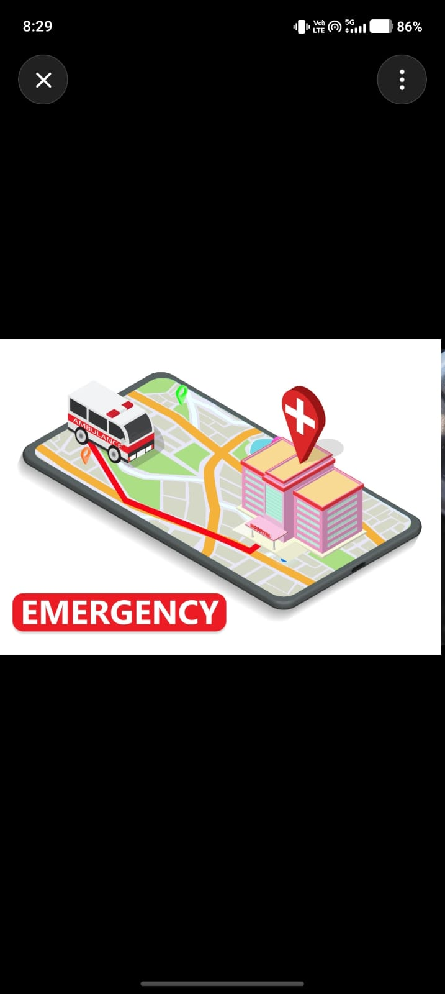
System Architecture
Include a flow diagram:
Vehicle/Sensor Data → Python Processing → AI Detection → Accident Confirmation → Alert Generation → Emergency Services & Contacts
Architecture Description :
• Vehicle sensors continuously collect data such as impact force, speed, and motion status. • Python-based processing modules clean, analyze, and prepare the sensor data for evaluation. • AI algorithms examine the processed data to identify potential accident situations accurately. • The system verifies and confirms the accident to minimize false alerts. • Once confirmed, an automated alert containing accident details and GPS location is generated instantly. • Emergency services and registered contacts receive the alert, enabling faster rescue and response operations.

Slide 12
Technologies Used
Python Programming – Used to develop the accident detection and alert system.
CSV File Processing – Stores and manages accident records and sensor data efficiently.
Data Analysis – Analyzes collected data to identify accident patterns and trends.
GPS Location Tracking – Determines and shares the exact accident location in real time.
Artificial Intelligence (AI) – Automatically detects accidents using intelligent algorithms.
Matplotlib & Pandas – Used for data visualization, reporting, and performance analysis.

Slide 13

Advantages and Applications
Advantages
• Faster rescue response and emergency assistance. • Reduces fatalities by minimizing response time. • Automatic accident detection and reporting. • Accurate GPS-based location sharing. • Efficient storage and management of accident records. • Supports data-driven decision making through analysis and reports.
Applications
• Smart Vehicles for enhanced road safety. • Emergency Services such as ambulances and hospitals. • Traffic Management Systems for incident monitoring. • Smart Cities and intelligent transportation networks. • Fleet Monitoring for transport and logistics companies. • Road Safety Analysis to identify accident-prone areas.

Slide 14

Conclusion & Future Enhancement
Conclusion
• AI enables quick and accurate detection of road accidents. • Automated rescue alerts help reduce emergency response time. • GPS-based location sharing assists rescue teams in reaching victims faster. • Accident records can be stored and analyzed for future improvements. • Data visualization provides useful insights into accident trends and patterns. • Python offers an efficient platform for developing smart accident management systems.
Future Enhancement
• Integration with IoT sensors for real-time data collection. • Development of a mobile application for instant notifications and monitoring. • Real-time ambulance tracking to improve rescue coordination. • Machine Learning models for higher accident detection accuracy. • Cloud-based data storage for better accessibility and scalability. • Integration with smart city and intelligent transportation systems.

Slide 15
References
Sadaf Ayesha, Aqsa Aslam, Muhammad Hassan Zaheer, and Muhammad Burhan Khan, "CIRS: A Multi-Agent Machine Learning Framework for Real-Time Accident Detection and Emergency Response," Sensors, vol. 25, no. 18, 2025. P. Madhavi Latha, T. Lakshmi Naveena, T. Kavya Sri, and P. Sujana, "Smart Shield – Accident Detection and Alert System," International Research Journal on Advanced Engineering Hub (IRJAEH), vol. 2, no. 9, pp. 2342–2348, 2024. Raju Thommandru and Borugadda Swaroopa Ran, "IoT Based Automatic Vehicle Accident Detection and Rescue System," International Journal for Modern Trends in Science and Technology, vol. 10, no. 3, pp. 94–99, 2025. "Automatic Accident Detection System Using IoT Compared to the Systems that a Traffic Centre Uses for Accident Detection," Procedia Computer Science, vol. 231, pp. 16–23, 2024.

